Slide 1
Fed Up of managing your health records??
Welcome to the smart way of digitally
managing health records

Slide 2

HealthVault
Choose with whom you want to share your medical records
Store & organize all your medical records at a single place.
Share your records with health care providers effortlessly.
Team 2ez4us

Slide 3

TEAM MEMBERS
01
Abhay Bajaj
02
Mihir Chowdhury
03
Abhishek Agarwal

Slide 4

Functionalities of the Product
It aims to develop the backbone necessary to support the integrated digital health infrastructure of the country. It will bridge the existing gap amongst different stakeholders of the Healthcare ecosystem through digital highways.

Slide 5
Product Specifications
Unique Health Id
Common Database
Nearby Healthcare Facilities
There will be a single common databse with medical history of all citizens of country
Every user who will register will get a unique healh ID.
Real Time Bed availability status and other related information regarding nearby healthcare facilities
Symptom Checker
Hassle Free
Reduces the hassle of carrying multiple papers and prescriptions by going digital
Shows the list of possible conditions.Not an actual diagnosis

Slide 6
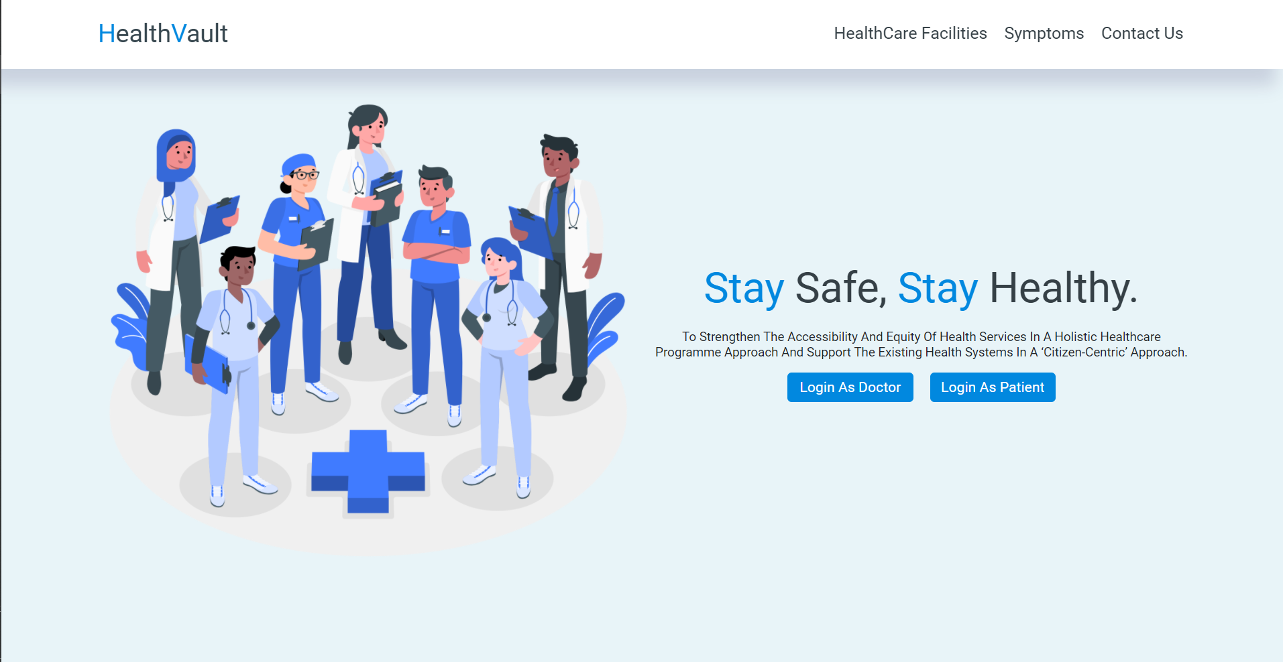

Slide 7
Finding nearby healtcare facilities

Slide 8
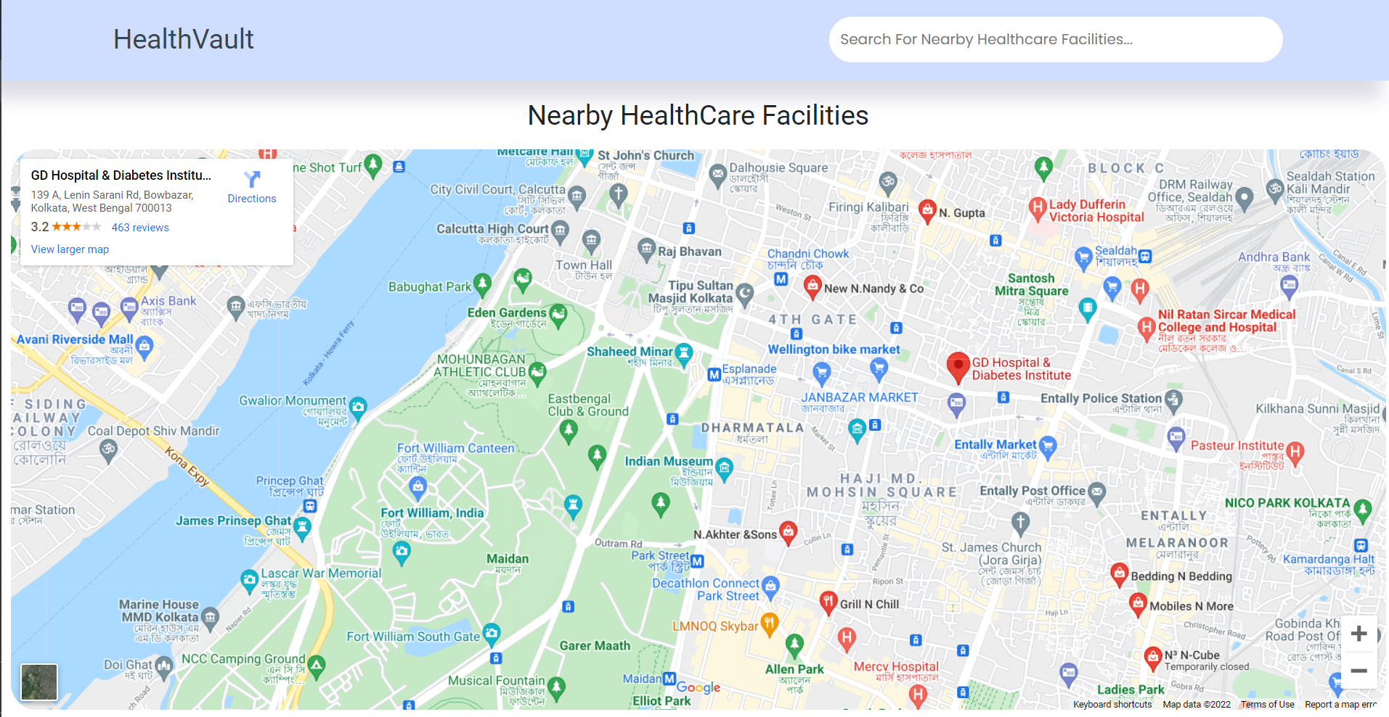

Slide 9
AI Powered Symptom Checker

Slide 10
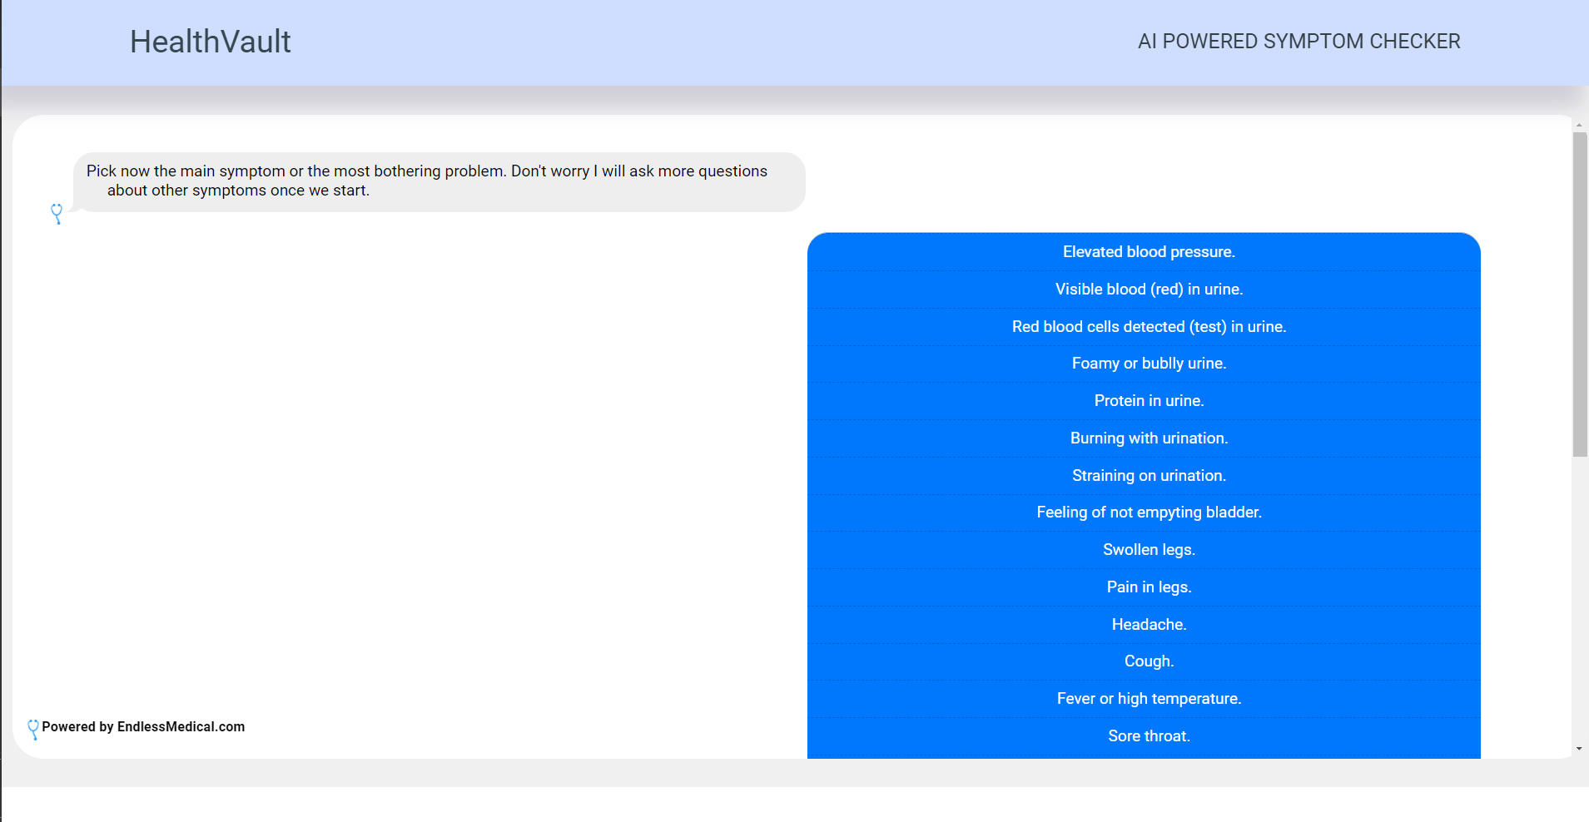

Slide 11
Facilities for doctors

Slide 12
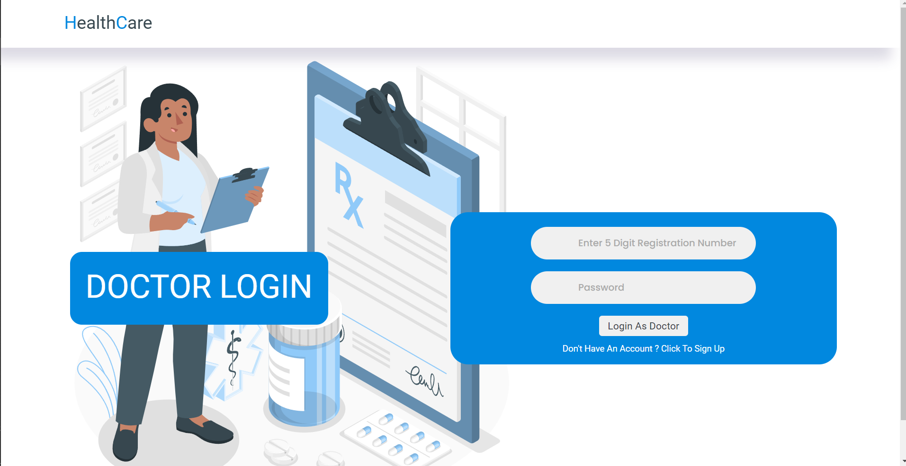

Slide 13
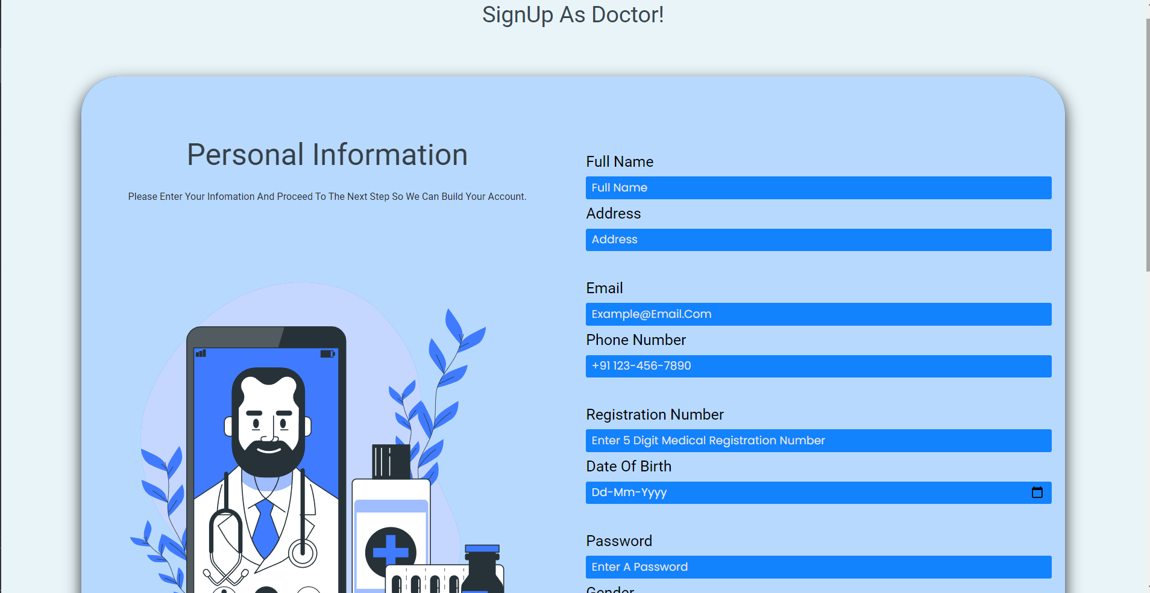

Slide 14
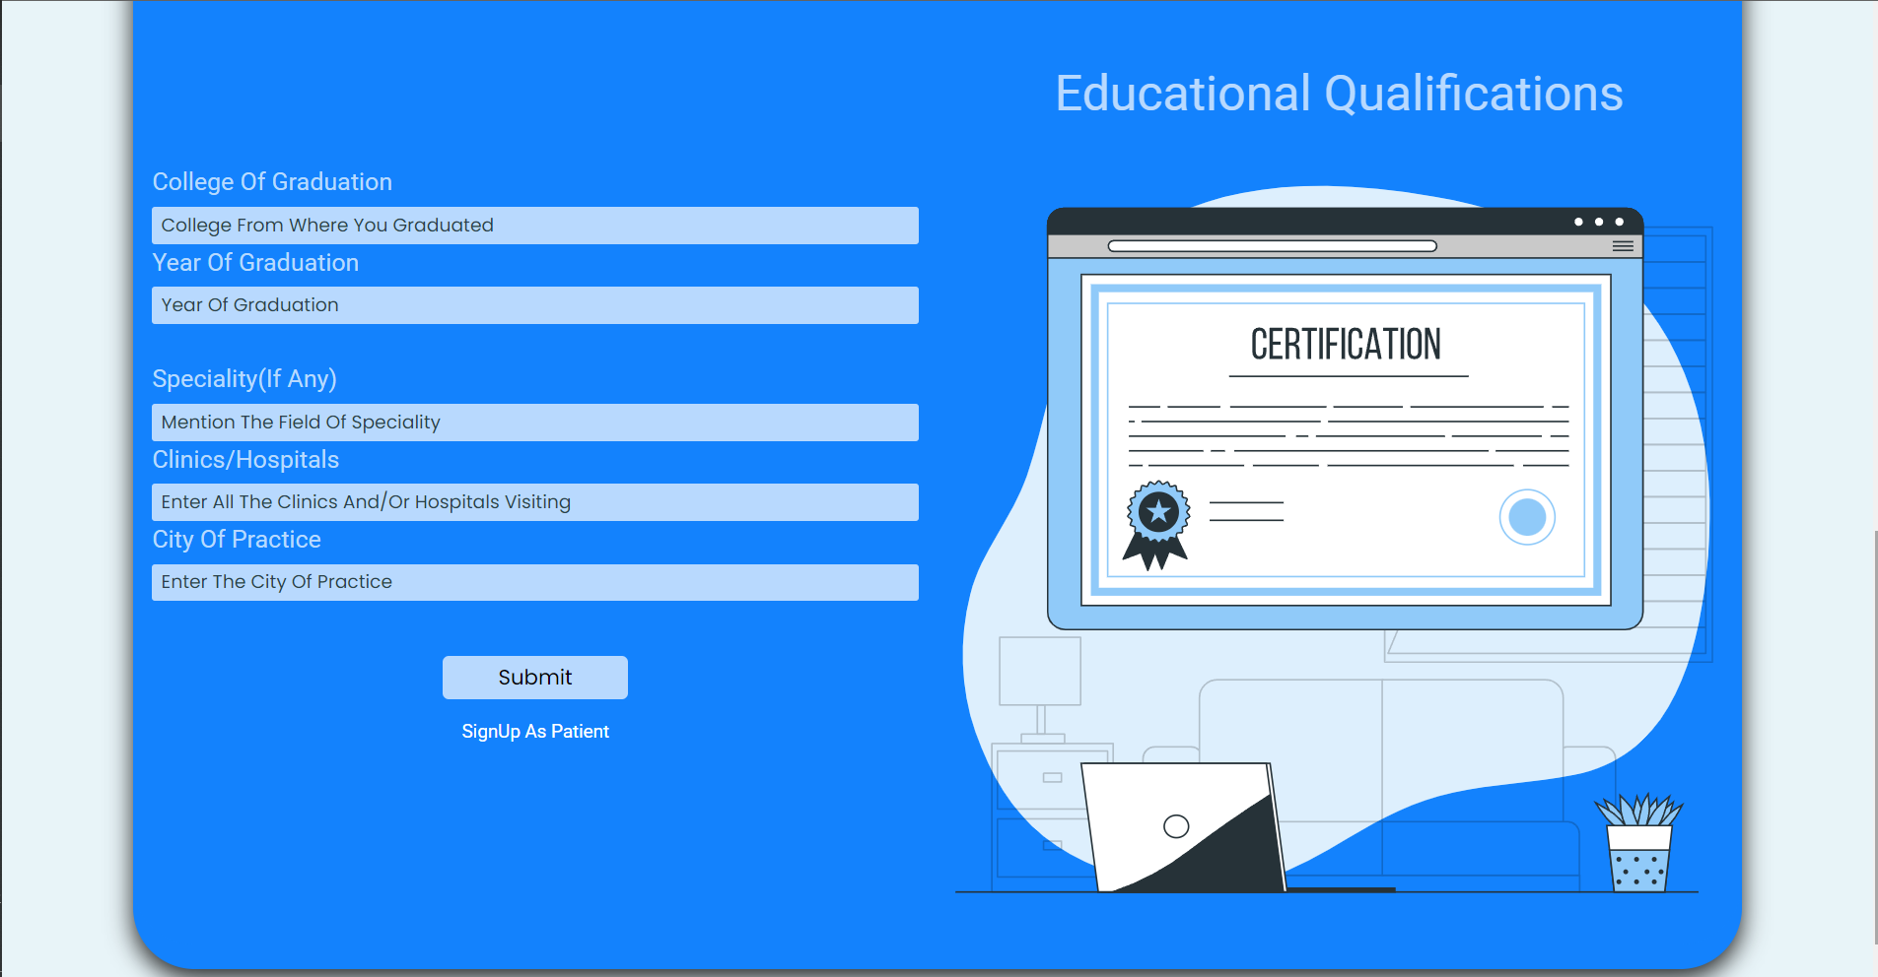

Slide 15
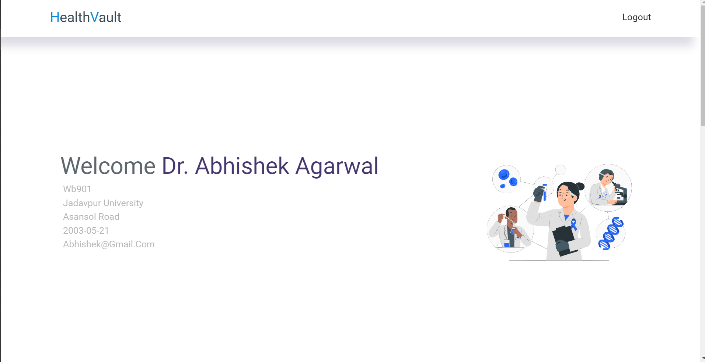

Slide 16
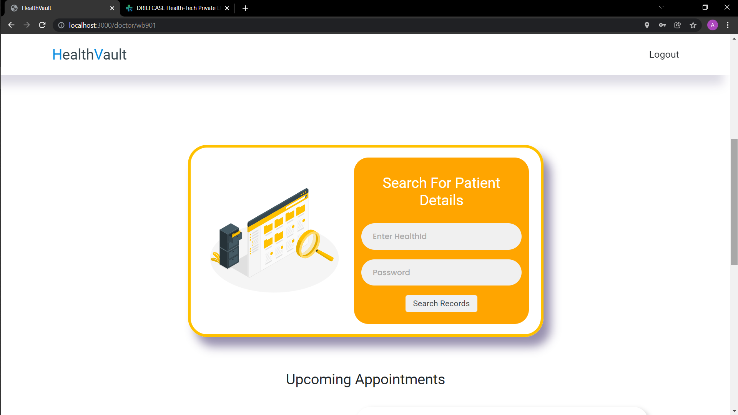

Slide 17
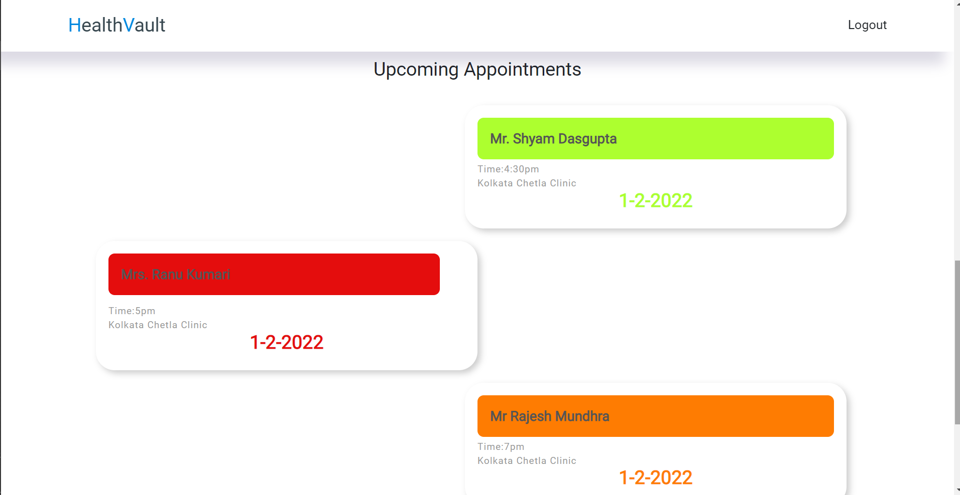

Slide 18
Facilities for patients

Slide 19
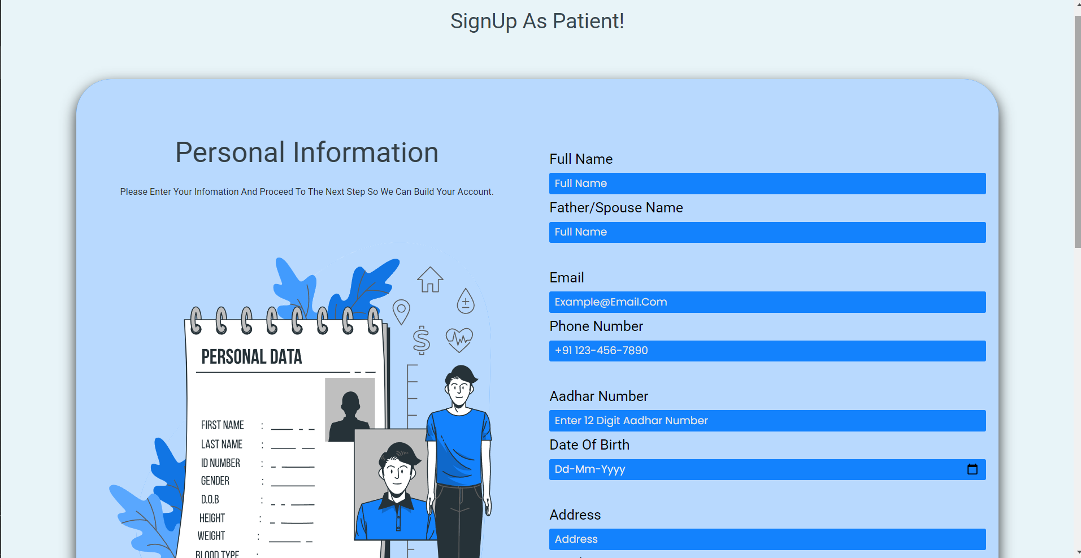

Slide 20
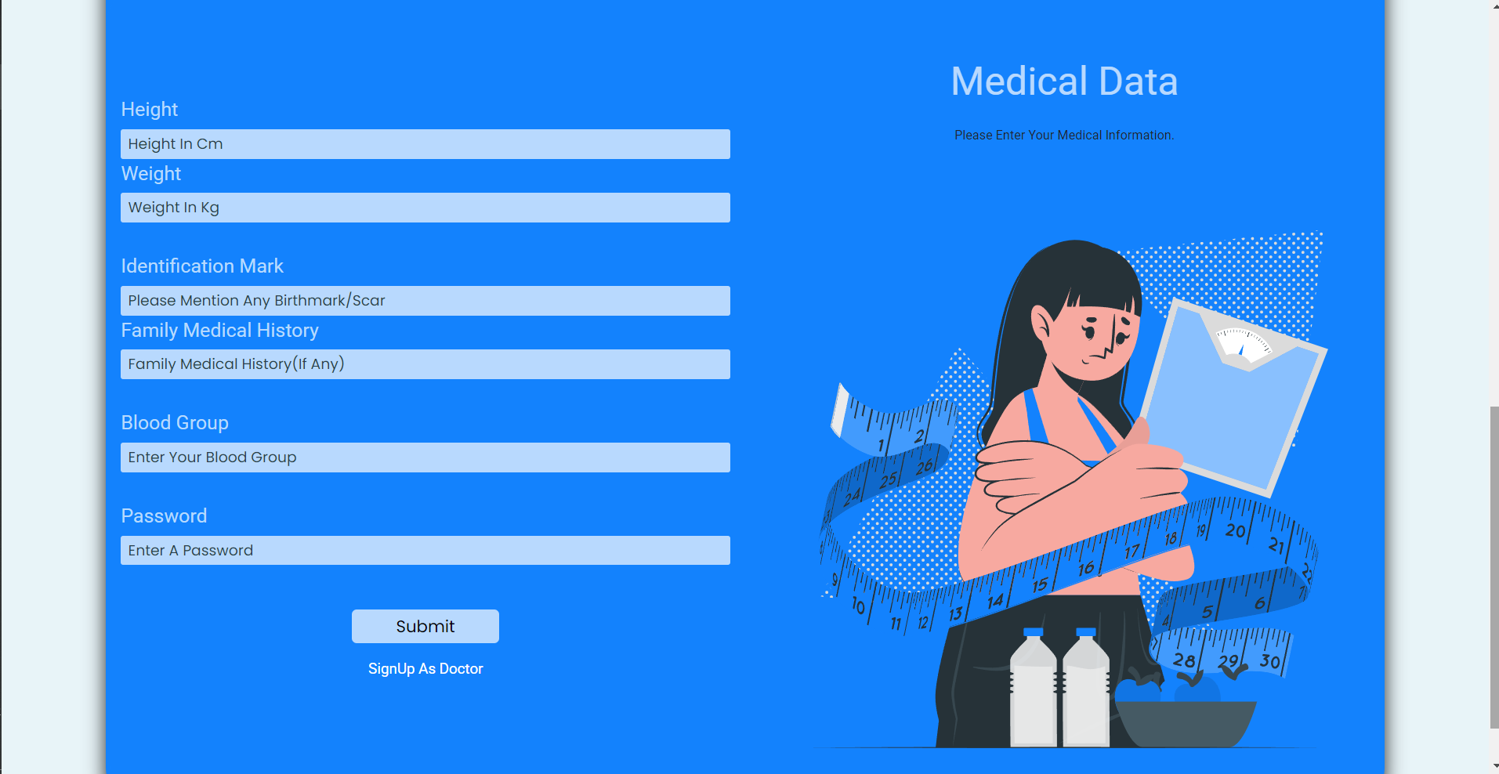

Slide 21
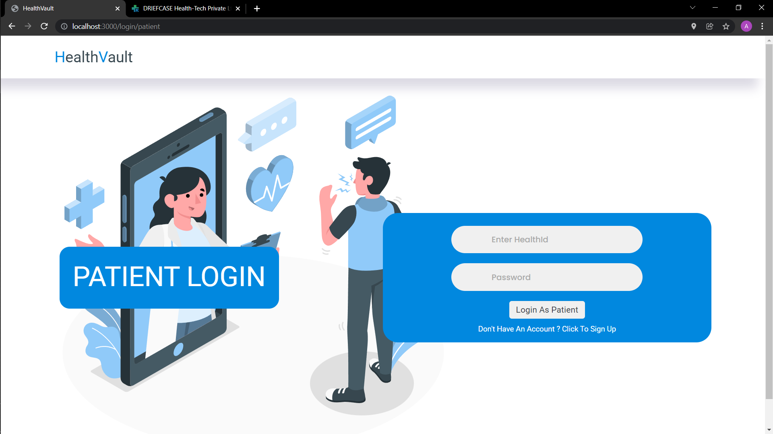

Slide 22
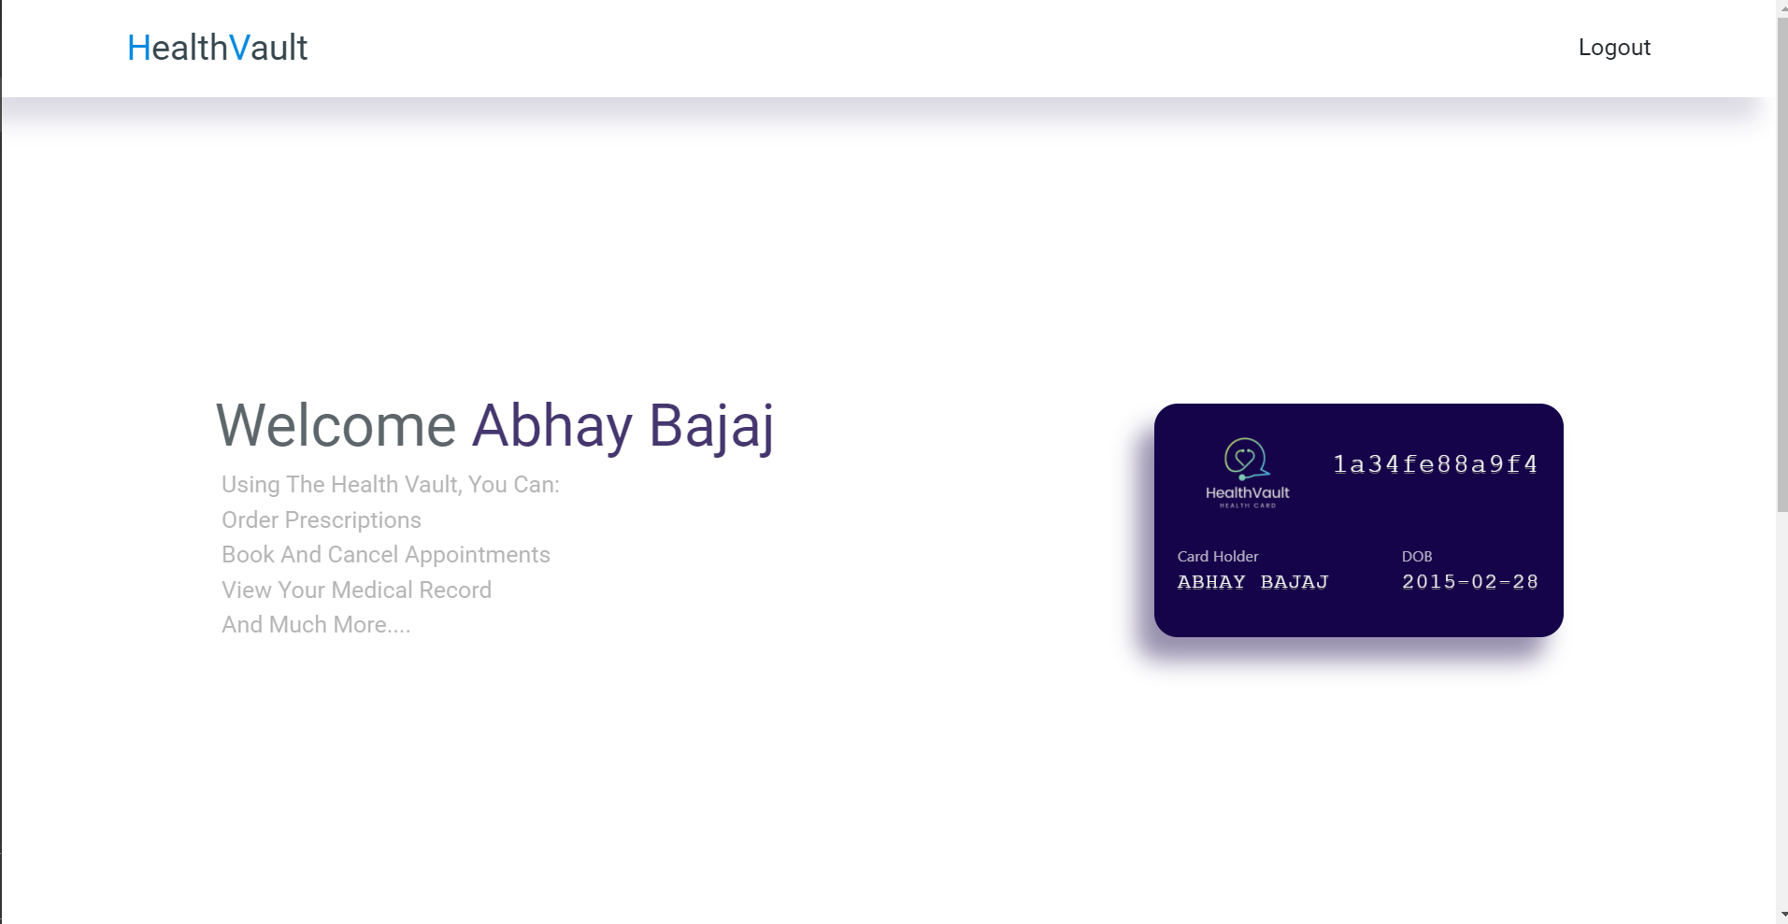

Slide 23
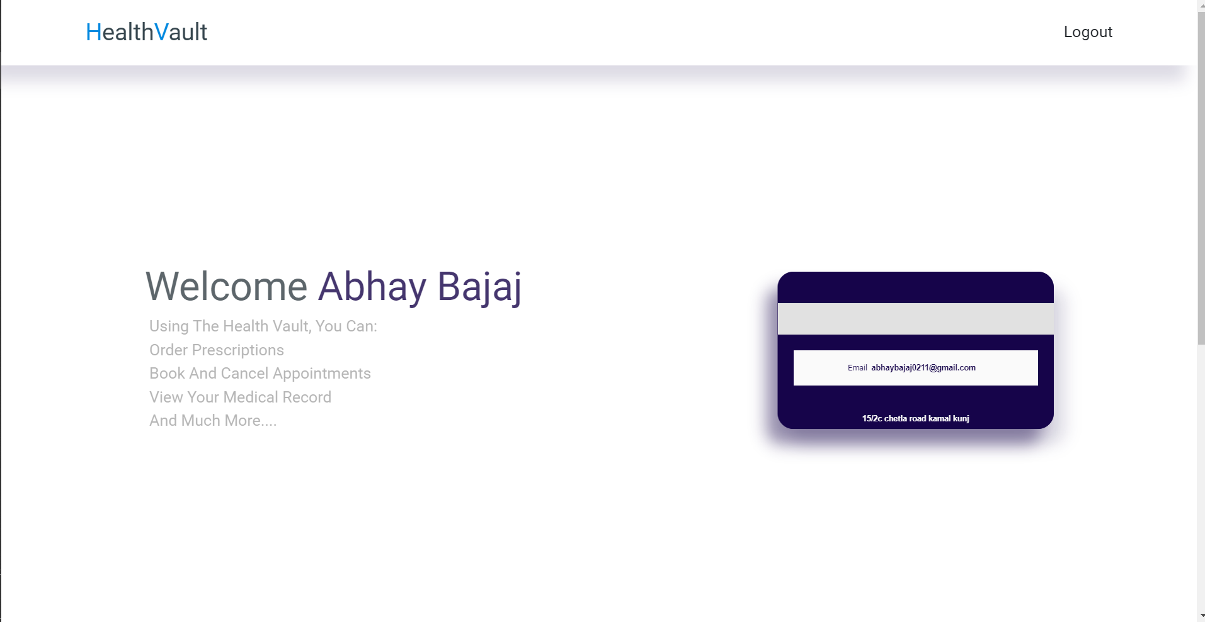

Slide 24
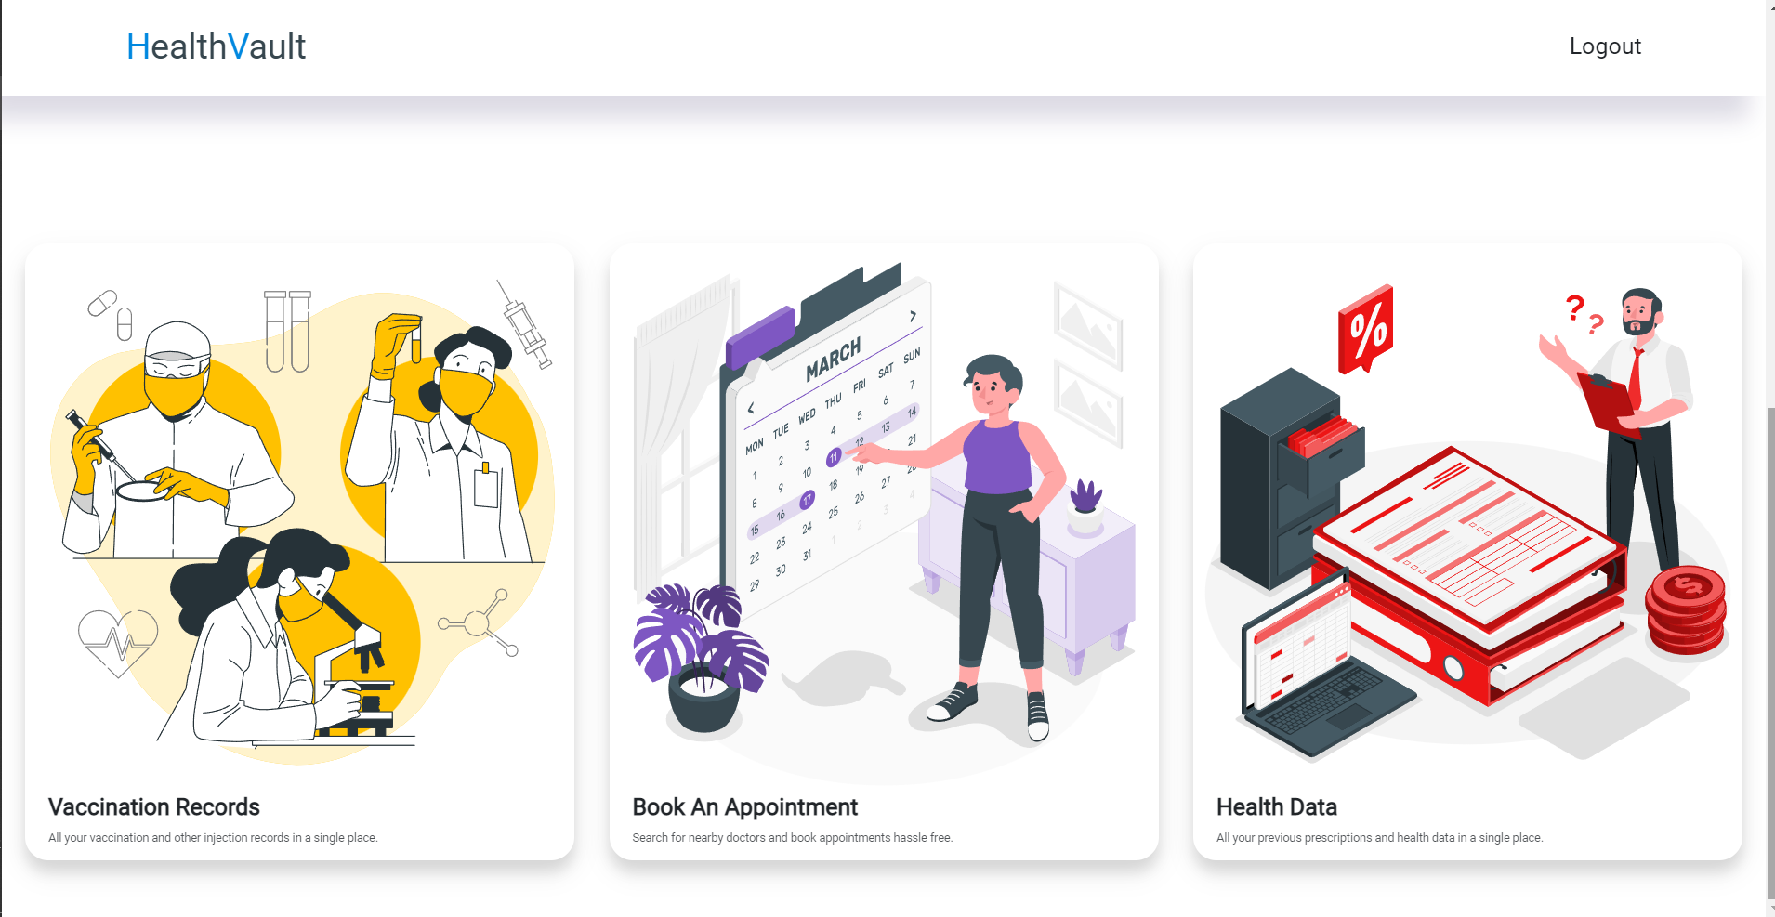

Slide 25

THANK YOU FOR WATCHING

